Slide 1
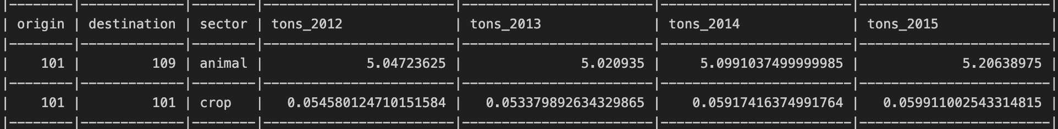
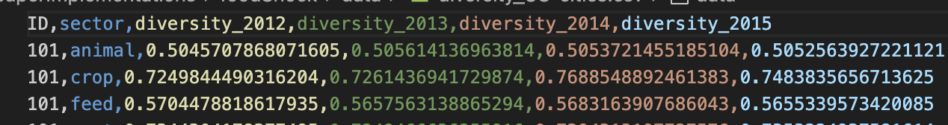
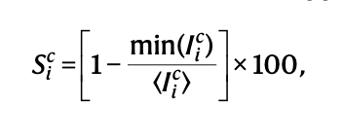
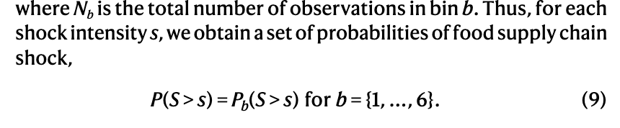
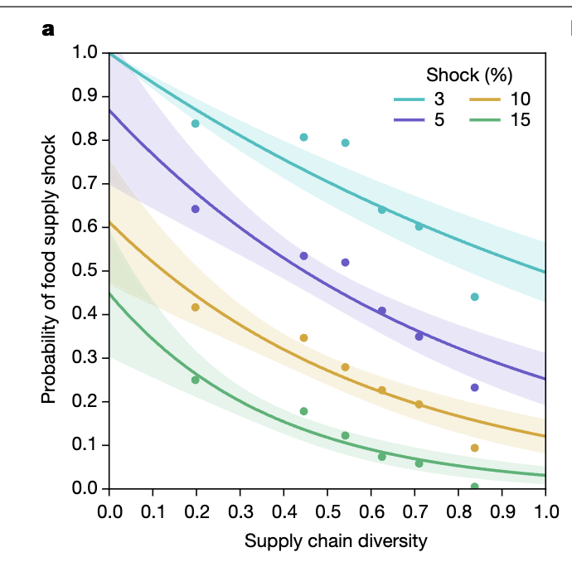
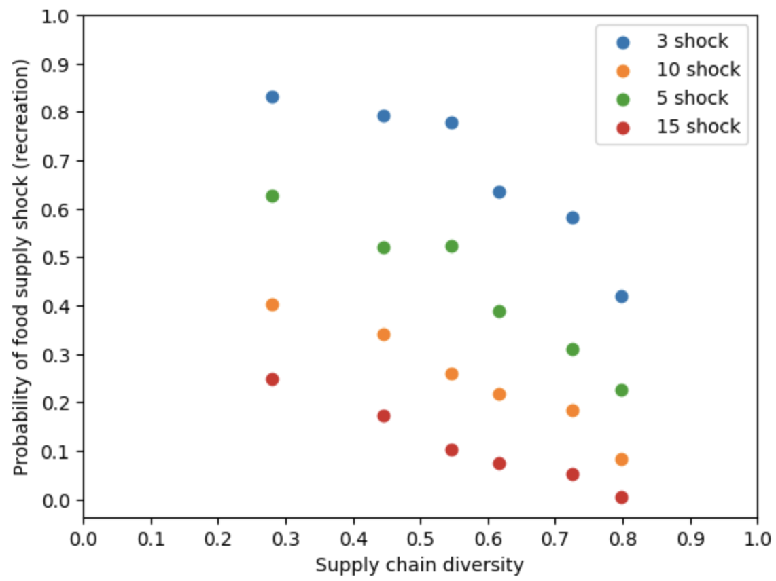
Supply Chain Resilience
Vareesh Balaji
Implementation
Supply Chain Inspitation
Network Failure Simulation
The paper referenced:
The paper did not have code for replication so reimplemented the paper to establish understanding
Goal:
Find the correlation between food shock resilience and designated diversity metric
Datasets:
Food flow networks by year
Diversity of locations by sector
Equations:
First equation shows the calculation of the S in each year of food supply.
Second equation shows the usage of first equation in each bin to create a simulation
Paper Result:
Simulation Result:
Diversity Correlation with Exports
Diversity Correlation with Exports
Diversity Metric

